Slide 1
Mantid Developer meeting
Release 2.5
9th May 2013

Slide 2
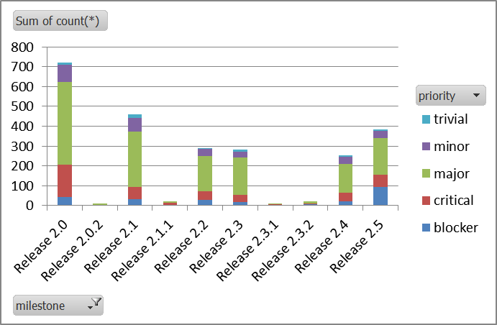
Release Summary
13 weeks
2 weeks maintenance
9 weeks feature development
1 week testing and release
385 Fixed Tickets
PV 3.98 Integration
Workflow Changes
Development
Testing
Release
5 Months

Slide 3

What went well? What could have gone better?

Slide 4
How to Test Tickets
http://www.mantidproject.org/Individual_Ticket_Testing
Git Refresher
http://www.mantidproject.org/Git_Workflow

Slide 5
Maintenance Fortnight
Timebox Deadline: 20th May
Directly Assigned Tickets
Some tickets will require input from others
High priority work
Retirement of Python API v1
Other ideas for maintenance work
This release
Future

